Slide 1
LOW COST HOUSING
FOR BHUTANESE REFUGEES IN THE UNITED STATES OF AMERICA
Presented by – Amol Vichare

Slide 2

SHREE GANESHAYA NAMAH:

Slide 3
INTRODUCTION
I am a Civil / Structural Engineer working with CH2M HILL and a volunteer/ member of various organizations like
  SEWA International
  Habitat for Humanity
  Internal Revenue Service
  American Society of Civil Engineers – Georgia Chapter
  American Society of Steel Construction

Slide 4
DISCLAIMER
This presentation is intended to spread awareness, throw some ideas on the table and to initiate a thought process or discussion about low cost housing options available in the USA
Some of the information presented here may not be applicable to Bhutanese refugees at the moment but could be used in the later years
SEWA International - Atlanta chapter does not represent any of the organizations mentioned in this presentation
This presentation is intended for educational purposes only and do not replace independent judgment. Statements of fact and opinions expressed are those of the individual participant/ presenter and not the opinion or position of SEWA International (Atlanta chapter) or its co-sponsors or its committees. SEWA International (Atlanta chapter) does not endorse or approve, and assumes no responsibility for, the content, accuracy or completeness of the information presented

Slide 5
Today we are going to talk about…
The need for Housing
Federal Government Initiatives for Low Cost Housing
Various other organizations that can help in providing low cost housing
Applicability of information presented
Questions / Comments / Discussions

Slide 6
EXISTING LIVING CONDITIONS
Most Bhutanese Refugees live in old and dilapidated apartments in high crime zone areas
More family members live in one or two bedroom apartment than most American families
Water seeping from roof, heaters not working, window panes broken… etc…!
A habitable living condition is important to improve their Self-respect, and give them a sense of belonging towards the USA

Slide 7
FEDERAL GOVERNMENT INITIATIVES
U.S. Department of Housing and Urban development has three separate programs for affordable housing
  1. The HOME Investment Partnerships
  2. Self-Help Homeownership (SHOP)
  3. Homeownership zone

Slide 8
U.S. Department of Housing and Urban development (www.hud.gov)
FEDERAL
GOVERNMENT
INITIATIVES
The HOME
Investment
Partnerships
SHOP
HOME
Ownership
Zone
Habitat
for
Humanity
Housing
Assistance
Council
ACRON
Housing
Corporation
Community
Frameworks
PPEP
MICROBUSINESS
& HOUSING
DEVELOPMENT
CORPORATION
Notes:
The Home ownership zone program has not been funded since 1997.

Slide 9
1. The HOME Investment Partnership
HOME is the largest Federal block grant to State and local governments designed exclusively to create affordable housing for low-income households
Each year it allocates approximately $2 billion among the States and hundreds of localities nationwide.

Slide 10
2. SELF-HELP HOMEOWNERSHIP (SHOP)
Provides funds for non-profit organizations to purchase home sites and develop infrastructure
Based on sweat equity and volunteer-based for low income families
Current SHOP Grantees
  Habitat for Humanity - Nationwide
  Housing Assistance Council - Nationwide
  Acorn Housing Corporation – IL, AZ, AR, NY, LA, TX
  Community Frameworks – WA, OR, ID and MT
  PPEP Microbusiness And Housing Development Corporation – AZ, CO and NM

Slide 11
HABITAT FOR HUMANITY
WHO CAN BUY A HOUSE FROM THEM?
YES… YOU HAVE TO BUY A HOUSE FROM THEM… ITS NOT FREE…!

Slide 12
Do Bhutanese Refugees Qualify?
    ELIGIBILITY CRITERIA
First time home buyers
Citizen or legal resident lived in the area for the past year
Have at least 2 and less than 8 people in the household
Steady income for at least 2 years
Good credit
No bankruptcies
Hold a bank account
YES
YES
YES
MAY BE?
MAY BE?
YES
YES

Slide 13
BENEFITS
No Interest Mortgage
Low Monthly Payments $550 - $650/ Month
Low Down Payment (~$750)
Energy Efficient Home
Attractive Well Built Homes
Brand New Appliances
Handicapped Visitable

Slide 14
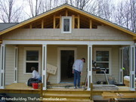
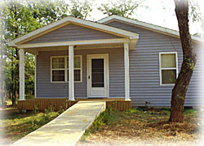
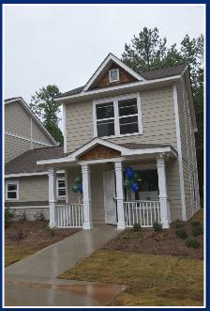
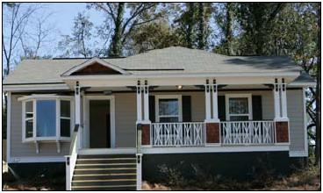
SAMPLE HOUSES BUILT IN USA

Slide 15
WHAT IS EXPECTED OF HOMEBUYER?
WHATS THE CATCH???
Invest 250 “Sweat Equity” Hours
Live in the House For at least One Year
Make Timely Payments
Attend 12 Home Buyer Education Classes
IT’S A LOT OF WORK…!

Slide 16
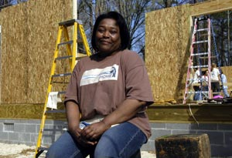
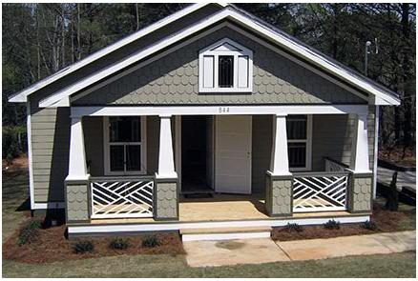
Some Experiences…
Worked as a nursing assistant
Tragedy struck her when her daughter was killed in a car accident
Leaving 3 grand kids
She lived in a small house with several other relatives – No room for the kids…!
Applies for Habitat for Humanity home
All-woman team along with other nurses and doctors with whom Virginia works came out to help her build her new home…!!!
Virginia Burden

Slide 17

My personal experience…!
I have worked on several houses in Birmingham, AL and Atlanta, GA area
As a corporate volunteer through my company and also through my university program
There’s satisfaction in knowing that you’re working virtually with strangers on a team project, helping someone else achieve a dream
Everybody can participate in some way. Everybody can serve out there, with a little bit of training and confidence in yourself

Slide 18
Loans For Self-Help Housing From Housing Assistance Council
HAC makes short-term loans at below market interest rates to local nonprofits, for profits and government entities developing affordable housing for low-income, rural residents
Self-help process enables low-income participants to build their own homes
Homebuyers use their own “sweat equity” to reduce the cost of their home
When a SHOP borrower meets its production goals and other requirements, up to 80% of its loan is forgiven

Slide 19
HOME Training offered via HUD.GOV
Instructor-Led training
  CDP Training Institute
  Over two dozen courses designed to share information with community development professionals, HUD staff, and other stakeholders as they work together to improve and renew America’s communities
Web-based training –
  HUD's Web-based training and technical assistance site (HOME Front )
  HOME Front has a series of interactive training and technical assistance modules
  Each module allows you to explore useful HOME topics in your own way and at your own pace

Slide 20
More alternatives for Low Cost Housing
Prefab / Modular Homes
Pre-engineered buildings
Architecture for Humanity – Non profit design services firm
Housemate match
Housing Choice Voucher Program (Section 8)
References used for this presentation
www.hud.gov
www.habitat.org
www.ruralhome.org

Slide 21

Thank you
QUESTIONS ???
COMMENTS
Lets try and help them make the USA their HOME by helping them build a HOUSE…!!!

